Slide 1
Presentation Times
Check-In
Rules & Requirements
Questions
PRESENTATION INFORMATION
Oral & Poster
Presentation Workshop: March 9th, 2022

Slide 2
Presentation Times
Presentation sessions: Monday, March 21st – Thursday, March 24th
Closing ceremony Friday, March 25th
Due to the deadline extension, poster and oral session time assignments have not been finalized.
You should receive an email within the next week with your assignment.
If you need a university-excused absence for the time of your session, please email srw@tamu.edu.
Professional Development sessions will also be occurring throughout the week. Register at: SRW 2022: Development Session Registration.

Slide 3
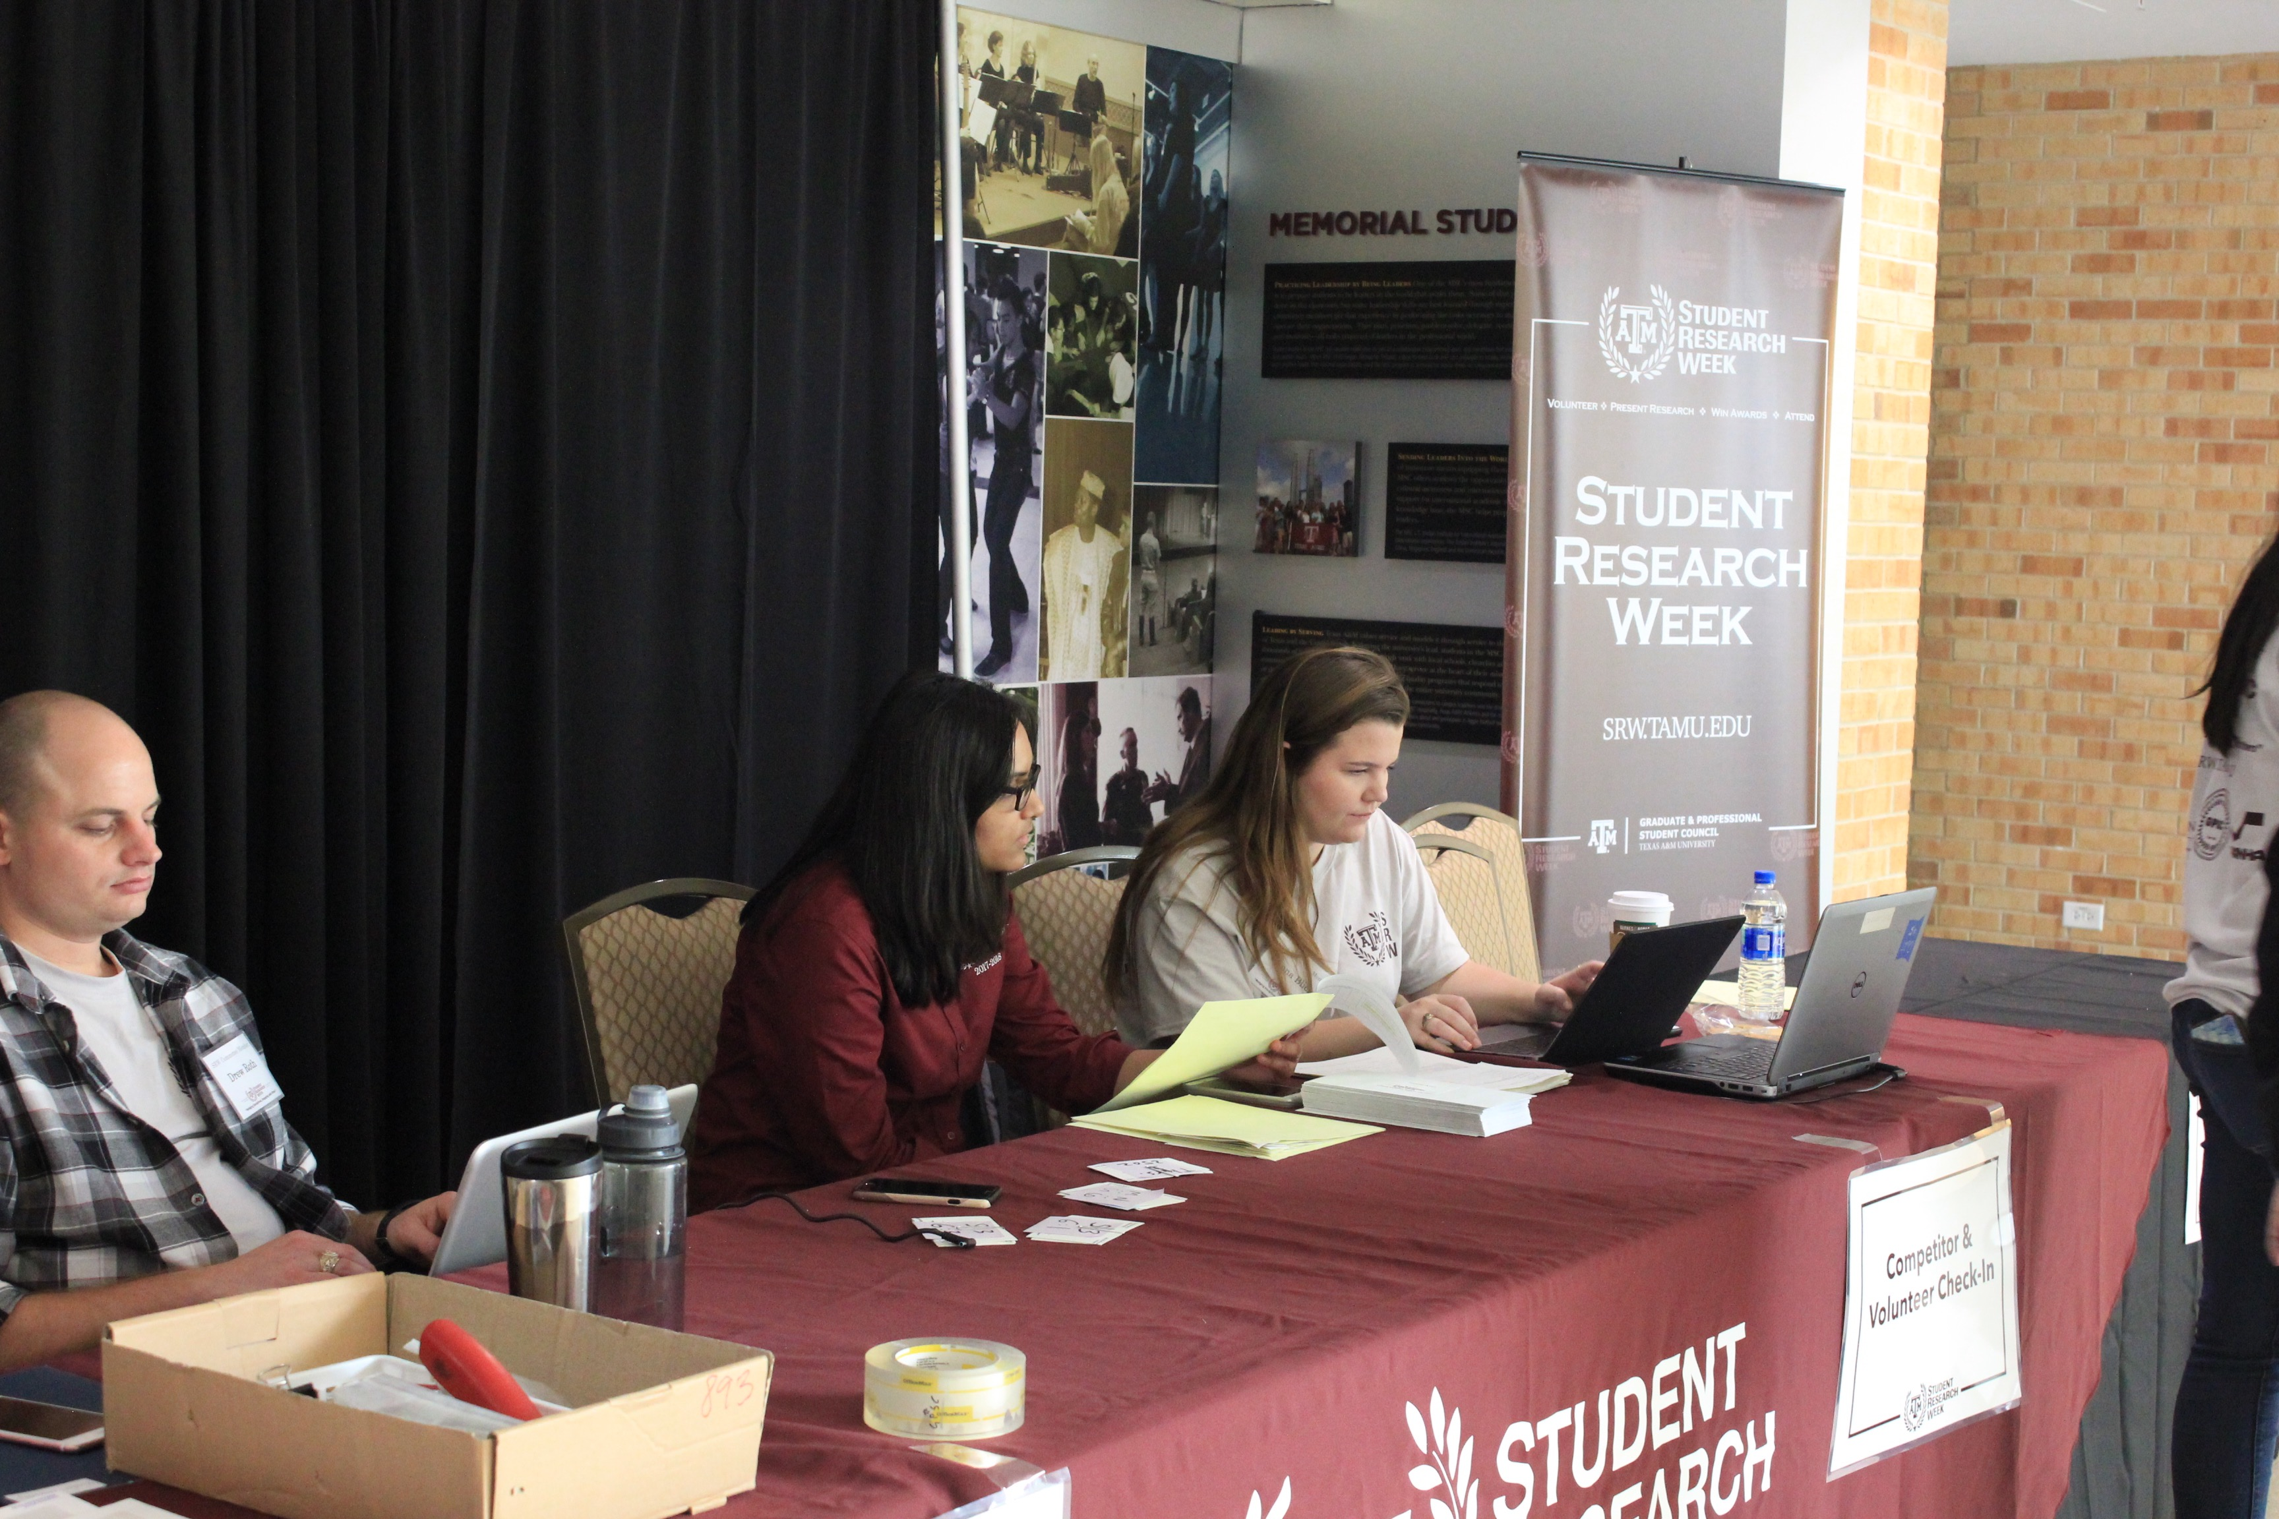
Check-In
Please check-in at least 20 minutes before your assigned session.
Poster presentation:
Bring printed poster and hang 15 minutes before assigned session
Oral presentation:
Arrive at presentation room 15 minutes before assigned session

Slide 4
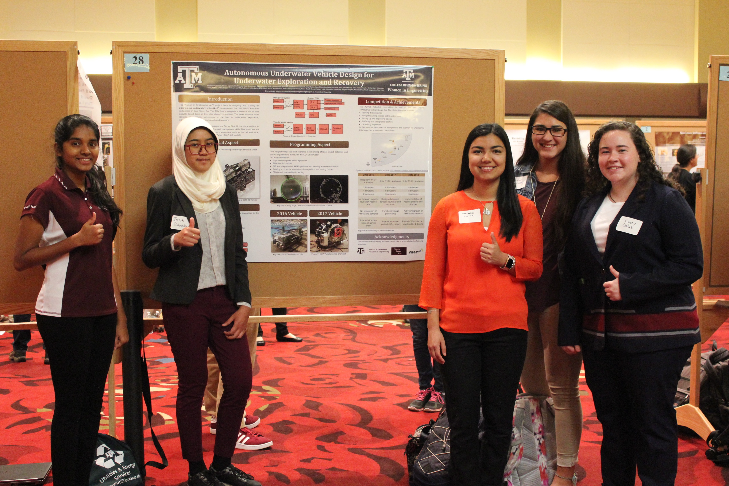
Rules & Requirements
General:
Research does not need to be complete to compete
Can compete as an individual or group

Slide 5
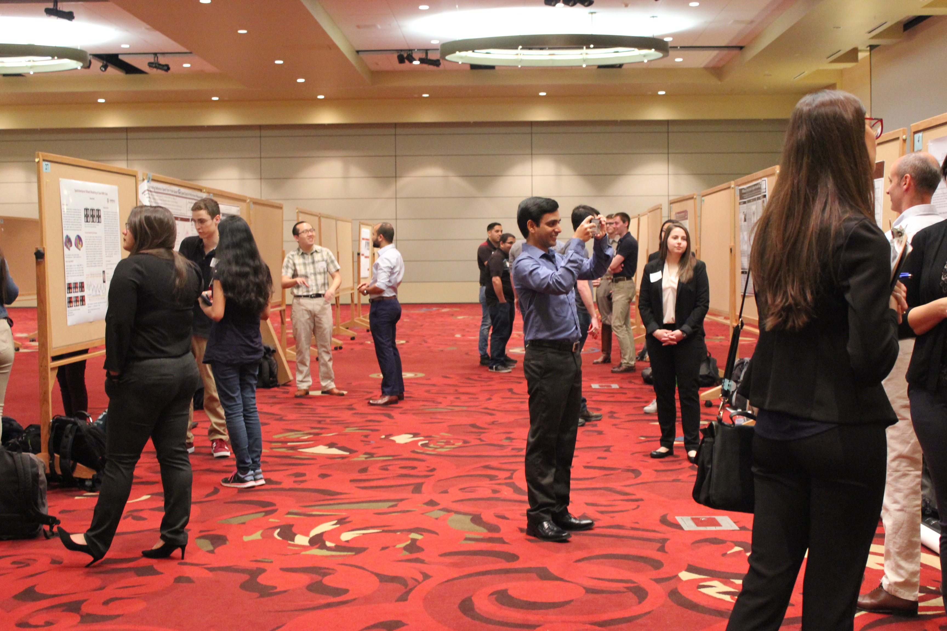
Rules & Requirements
Poster presentations:
NO required poster template. Reference department website or previous SRW posters.
Competitor is required to print poster and bring on day of assigned session.
Do not need to submit poster online (only abstracts need to be submitted online).
Poster dimension: ~48 x 36 inches, NO larger than 4 ft x 4 ft. Posters should have a horizontal orientation.
Poster printing options: Copy Corner MSC and Texas Avenue, Zachry Engineering Bldg., Langford Architecture Bldg., Office Depot, FedEx, Walgreens, CVS, etc. [Reminder: Spring Break may interrupt university business hours.]

Slide 6
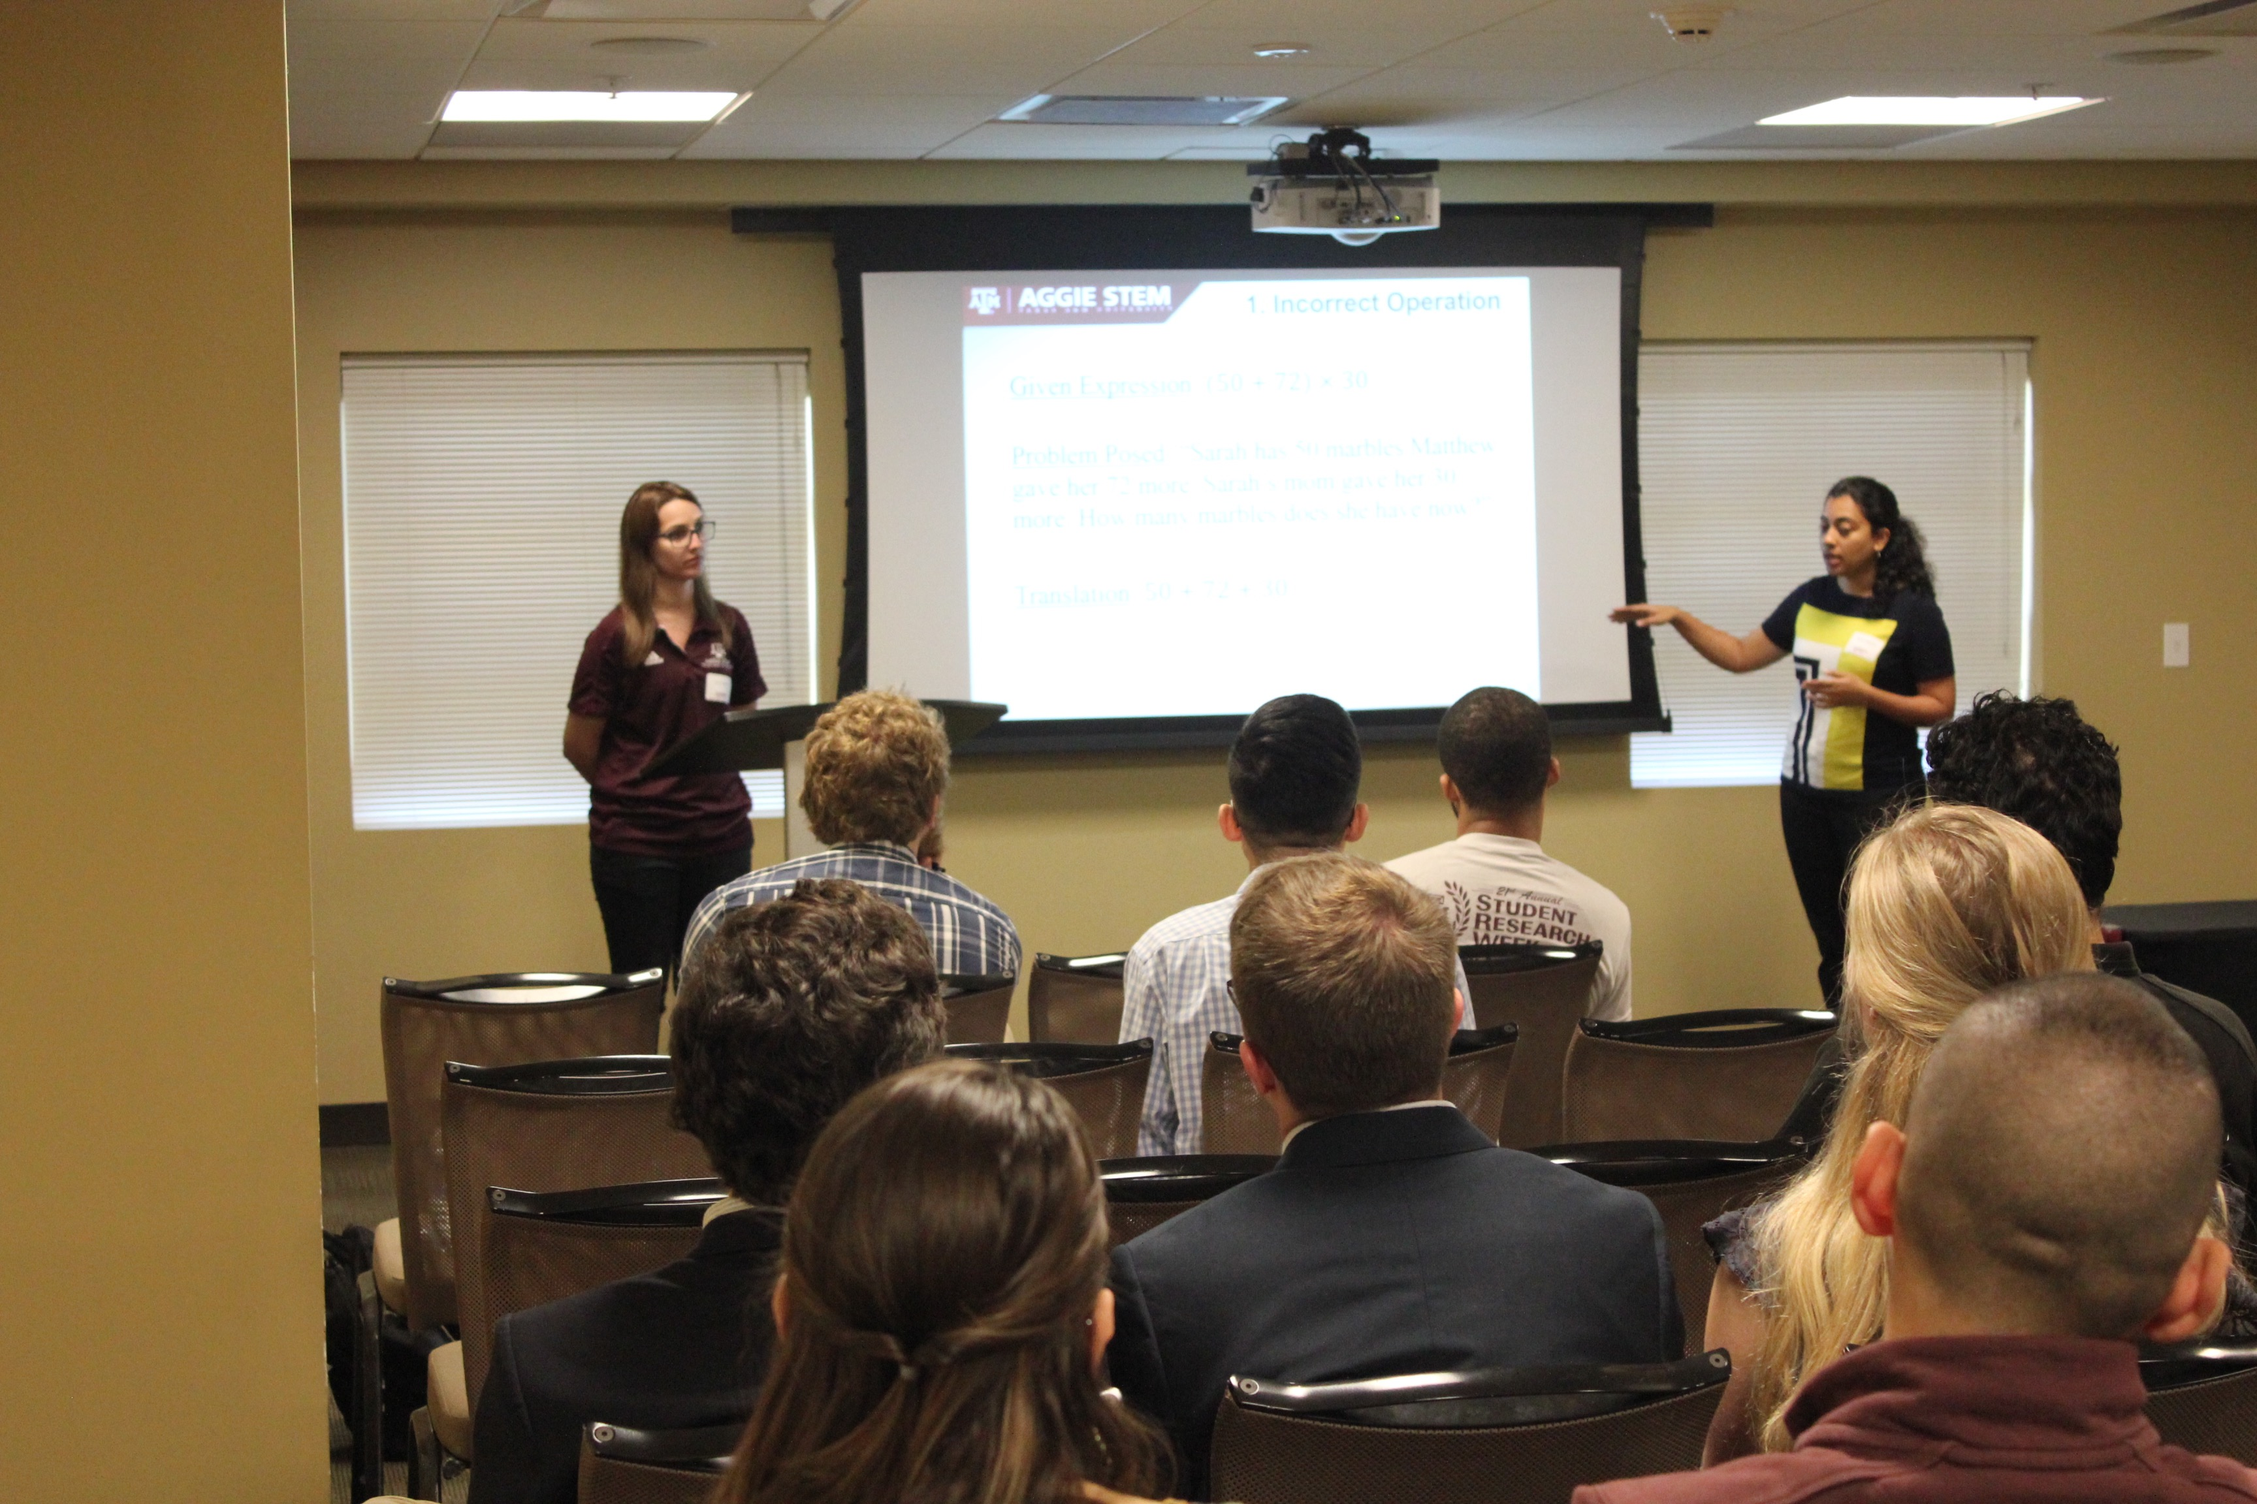
Rules & Requirements
Oral presentations:
Create a digital poster or PowerPoint presentation around 10-12 minutes.
Submit electronic copy of presentation by Friday, March 18th at 11:59 PM. An email with submission instructions will be sent out to registered participants.
Oral presentations: ~15 minutes = [10 to 12-minute presentation] + [3 to 5 minutes for questions]

Slide 7
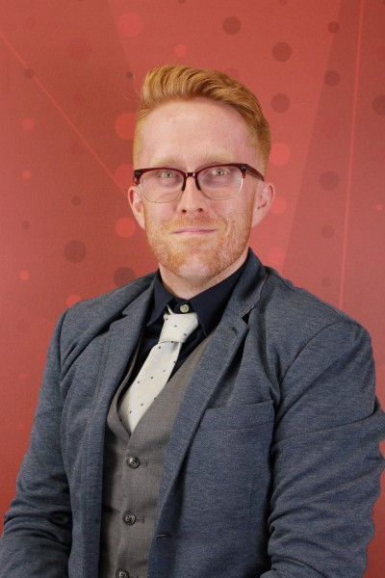
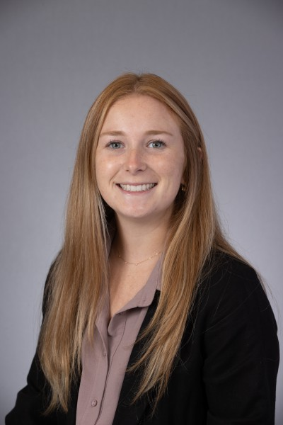
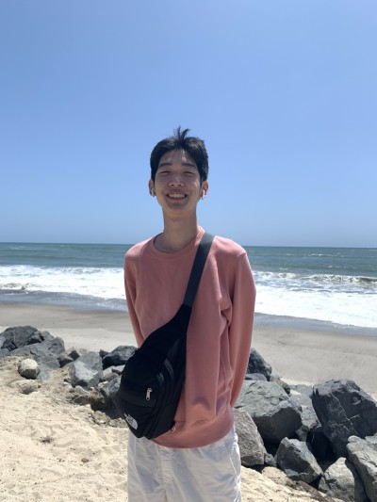
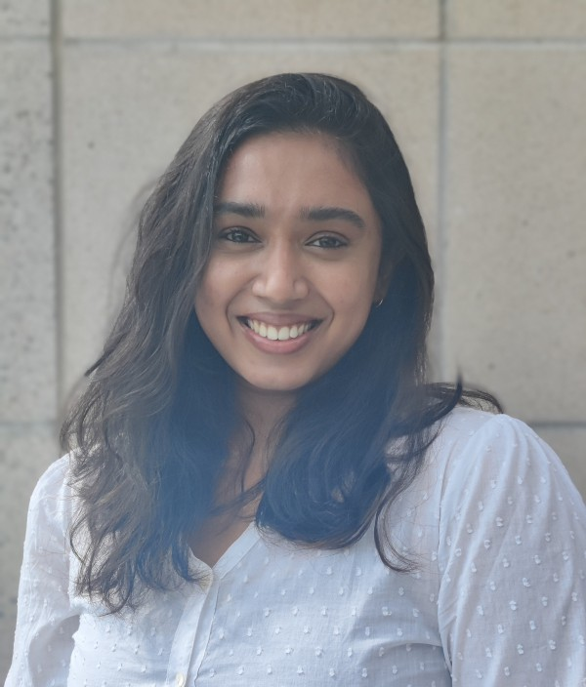
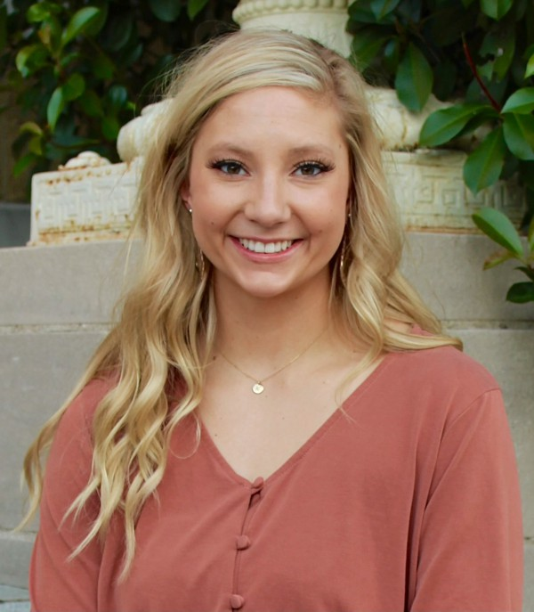
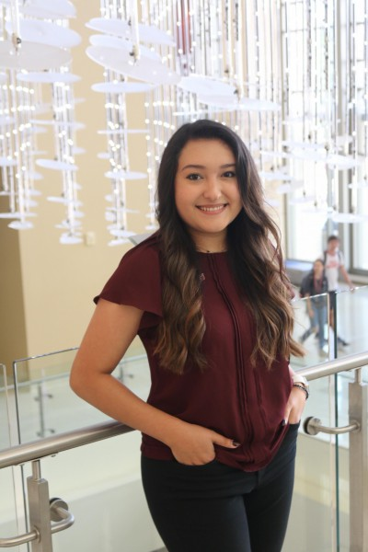
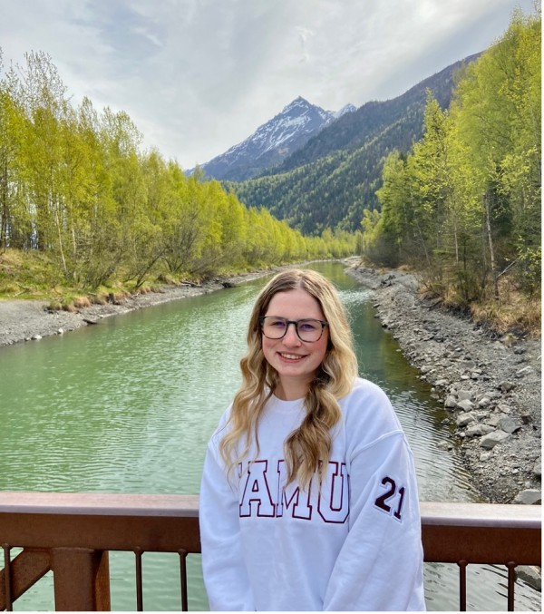
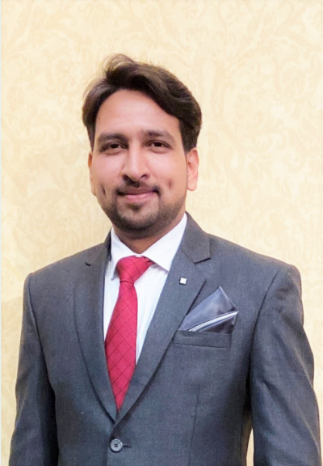
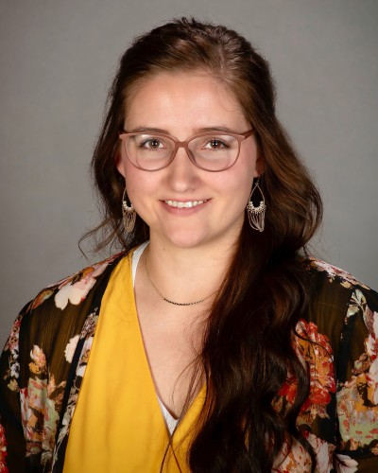
Questions
Additional questions may be emailed to srw@tamu.edu or visit our contact page: https://srw.tamu.edu/contactus/
GPSG Advisor
Director
Volunteer Coordinator
Marketing Coordinator
Sessions Coordinator
Logistics Coordinator
Judges Coordinator
Sponsorship Coordinator
Sessions Coordinator

