Slide 1
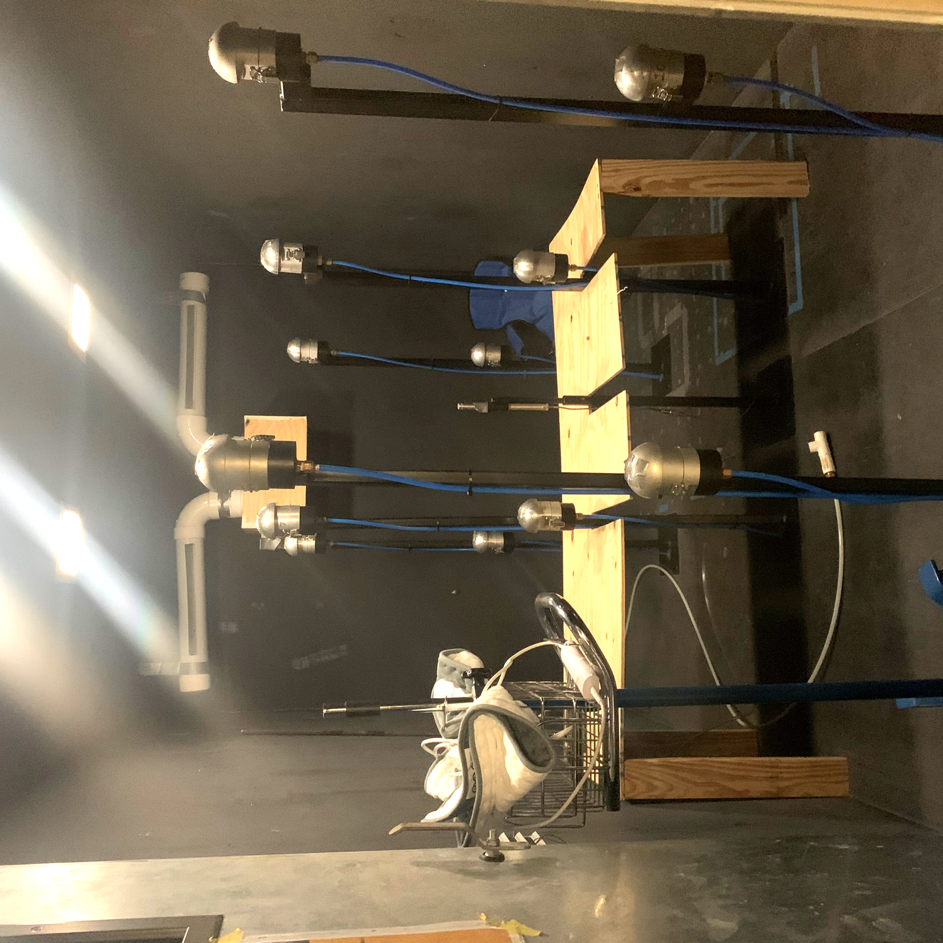
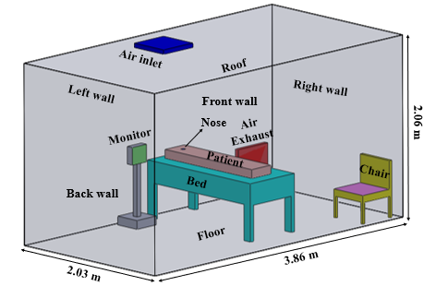
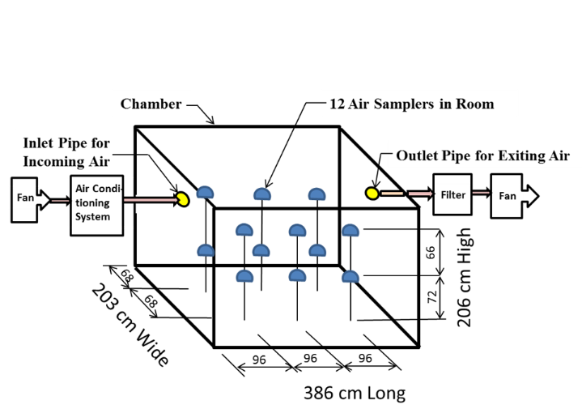
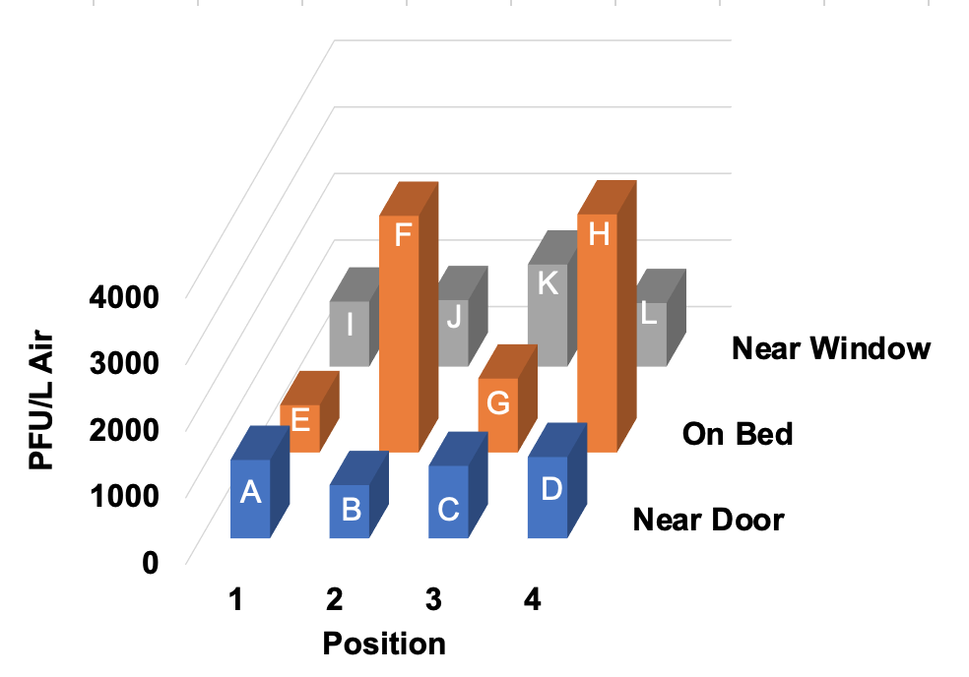
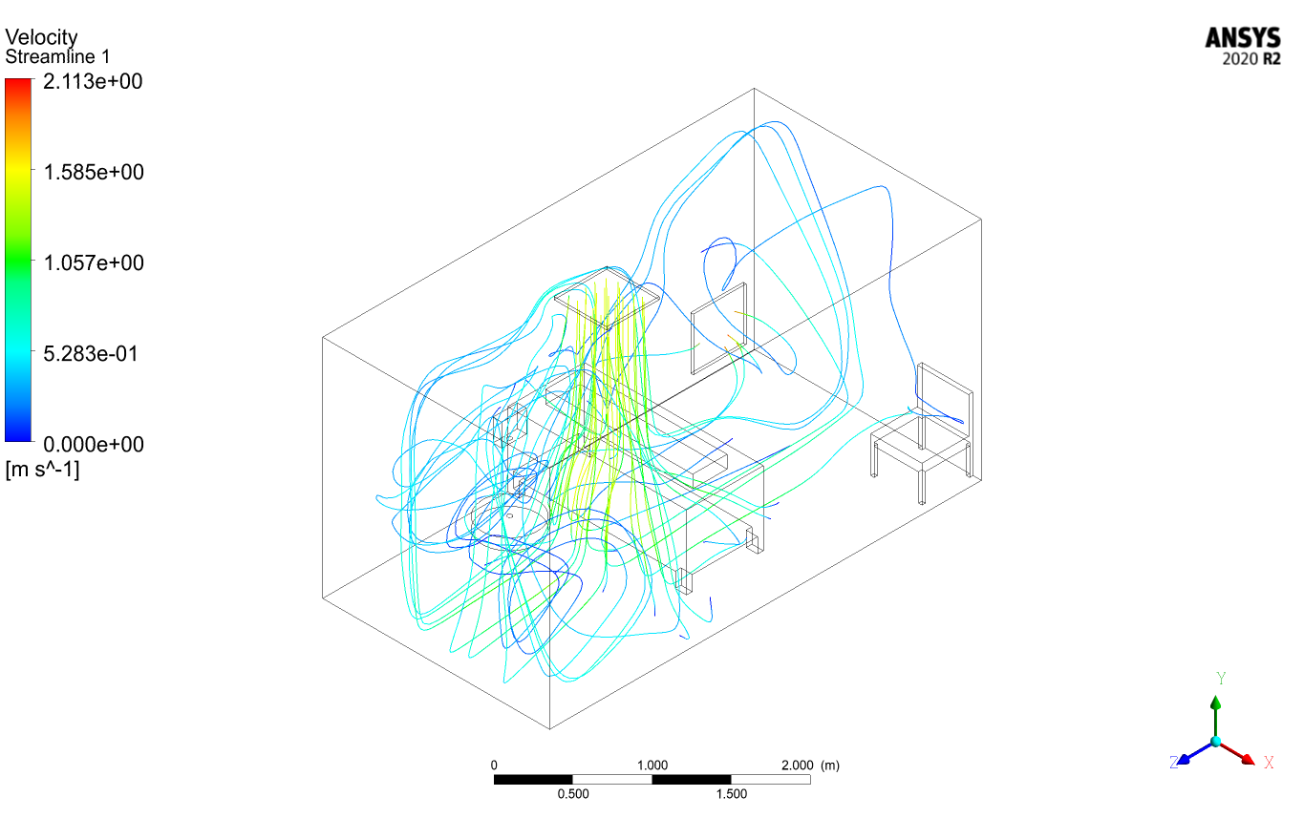
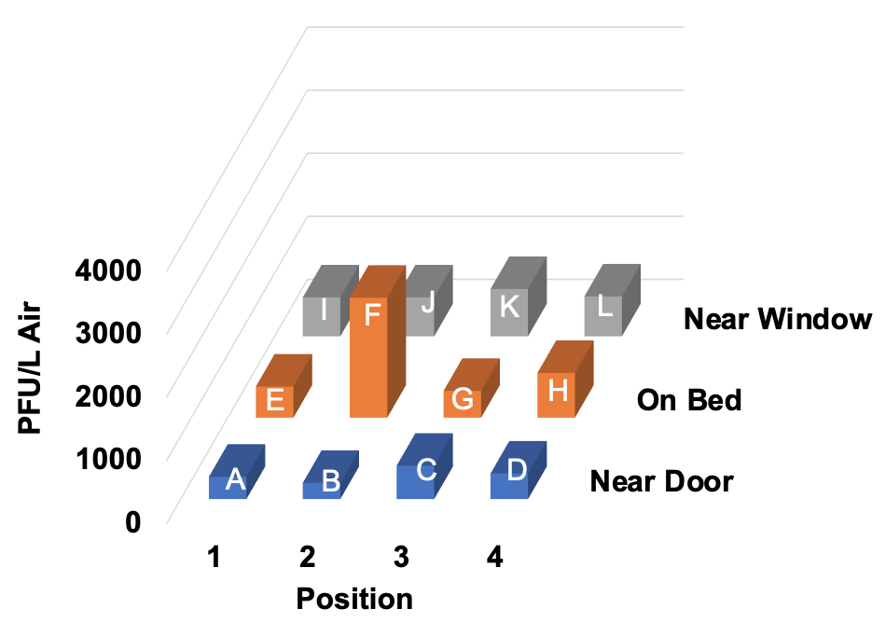
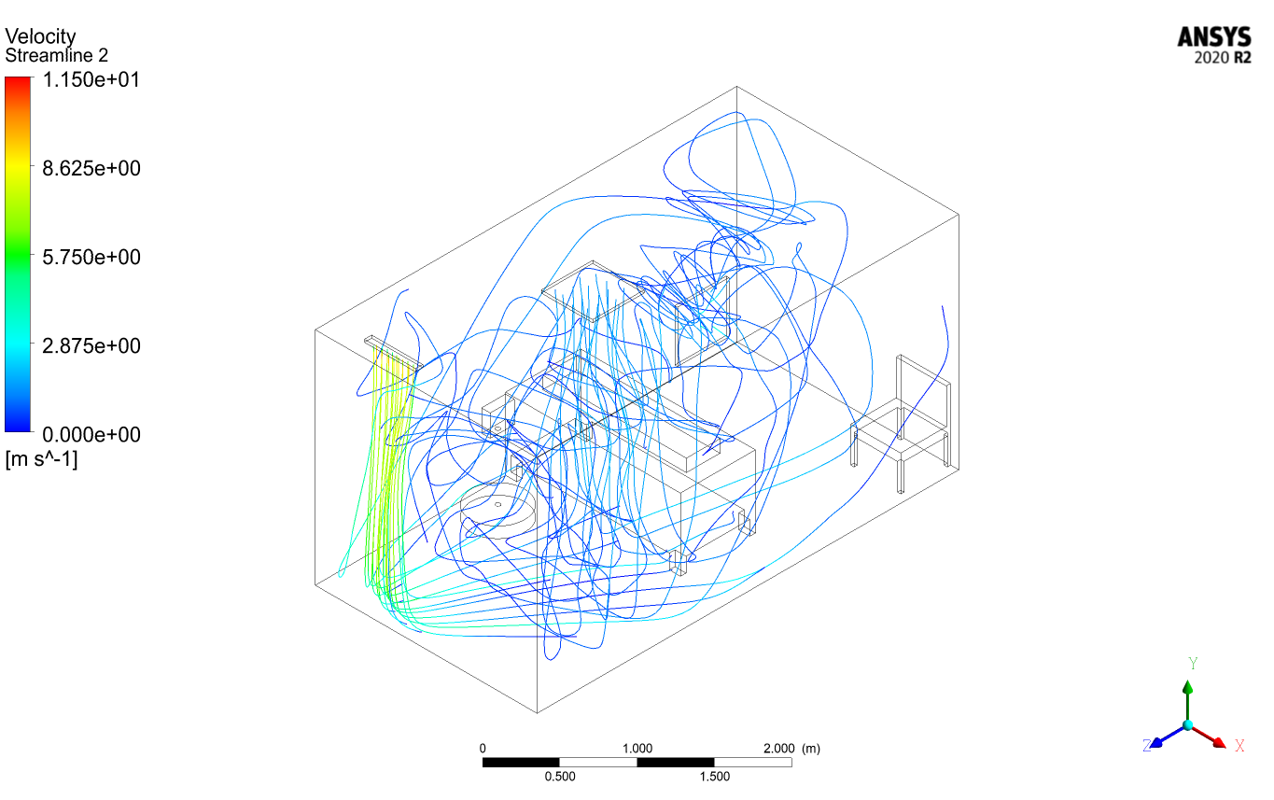
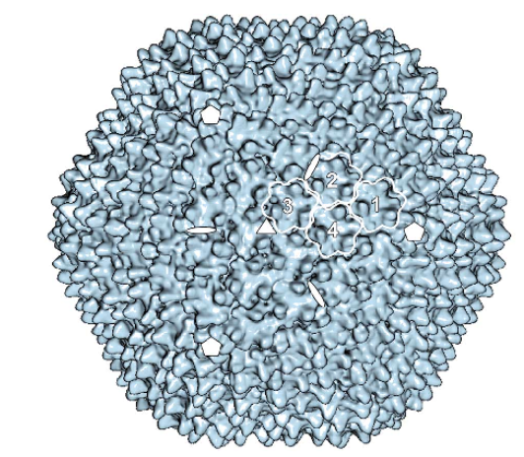
Viable Virus Transport in Ventilation Airflow
Tatiana Baig, Maria King (Advisor), Sunil Kumar
Department of Biological and Agricultural Engineering, Texas A&M University, College Station, TX 77840-3123, USA
Objective
Results
(a)Physical test chamber showing the location and labels of the twelve PM2.5 room air samplers arranged around the bed;
(b) Configuration of the hospital chamber: Air inlet on the ceiling on the right of the bed, with the exhaust on the left, air curtain above the door.
Conclusions
The objective of this study is to gain more knowledge on the effect of environmental factors on the spread and infectivity of virus aerosols in the built environment. Understanding how the virus transmits indoors would allow for early detection of viral particles in room sized spaces.
a
b
Particle concentration decreases at the air samplers by the door and around the patient with the air curtain on.
Without the air curtain particle concentration is heavier in front of patient head and at patient feet
Highest PFU/ L Air was found at Sampler F in both configurations, though there was a significant decrease in the configuration with the air curtain on. The air curtain had a significant impact on the number of particles that remain in the room
Streamline simulations mirror the experimental data collected in the hospital chamber, as shown in the graphs.
Without an air curtain, the particles remain in the room for longer before reaching the exhaust.
With the air curtain, particles are pushed away from the door and move out of the room through the exhaust.
I
E
A
K
G
C
Methodology
J
L
F
H
B
D
a
b
Back
Back
Schematic of the hospital chamber showing the locations of the twelve PM2.5 room air samplers in the chamber.
PM 2.5 Sampler
Front
12 PM2.5 samplers with 0.4 µm HTTP membrane filters were placed in the hospital chamber , arranged around the bed to collect air at 15 L/min.
Front
Without Air Curtain
Future
Research
The Texas A&M University Biosafety Level 2, air conditioned, ¾ scale hospital model chamber was operated at an air exchange rate of 6 air changes per hour(ACH) to test PRD1 bacteriophage as coronavirus simulants .
Portable Wetted Wall Cyclone at 100 L/min flow rate and twelve filter samplers were used to collect the aerosolized virus.
Two VBAC collectors at 100 L/min were used to sample PRD1 phages from the air at the patient’s bed and the exhaust.
Collison 24 jet atomizer, located at the head of the bed, aerosolized virus particles in the chamber.
Temperature, humidity and air velocity were monitored during sampling
Collected virus particles were plated and enumerated .
Results from aerosol collection were used to gain information on the temporal and spatial concentration of the airborne virus and the ability to remain viable during aerosolization and transport.
ANSYS Fluent computational flow model was created to simulate the entrainment of virus aerosols from a patient’s breath in the ventilation airflow, validated by aerosol collection results.
c
d
Back
Back
More tests will need to be conducted for longer testing times and different ventilation configurations
Additional tests are being conducted within a smaller plastic chamber using Bovine Coronavirus to test virus viability under different environmental conditions and air velocities
Front
Front
With Air Curtain
(a) Average Plaque Forming Units (PFU) per liter air of PRD1 Phage aerosolized and collected with the twelve samplers in the chamber show the spread of the aerosolized bacteria to other parts of the chamber from three 5 minutes tests without the air curtain on; (b) ANSYS Simulation without the air curtain showing the velocity streamlines of the air through the chamber; (c) Average Plaque Forming Units (PFU) per liter air of PRD1 Phage aerosolized and collected with the twelve samplers in the chamber show the spread of the aerosolized bacteria to other parts of the chamber from three 5 minutes tests with the air curtain, above the door; (d) ANSYS Simulation with the air curtain showing the velocity streamlines of the air through the chamber
References
Martín, C. S., Huiskonen, J. T., Bamford, J. K. H., Butcher, S. J., Fuller, S. D., Bamford, D. H., and Burnett, R. M. (2002). “Minor proteins, mobile arms and membrane–capsid interactions in the bacteriophage PRD1 capsid.” Nature Structural Biology, 9(10), 756–763.
24-jet Collison Nebulizer
PRD1 Bacteriophage

