Slide 1
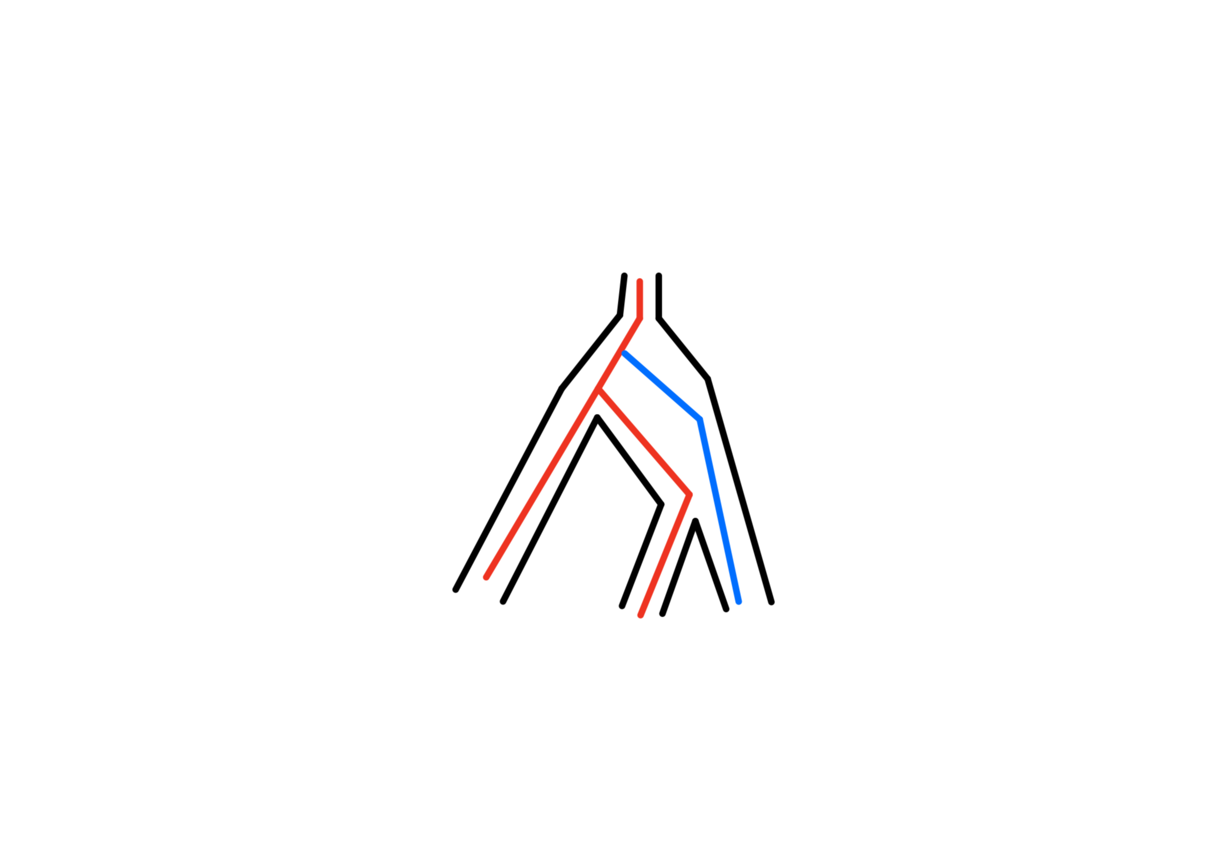
Detectability of Hybridization Across Varying Timescales in a Phylogenetic Context
Alix G. García¹, Emma Lehmberg², Gil G. Rosenthal^{1,2,3}
1. Department of Biology, Texas A&M University 2. Ecology & Evolutionary Biology Interdisciplinary Program 3. Texas A&M University, Centro de Investigaciones Científicas de las Huastecas “Aguazarca”
Introduction and Purpose:
From from the Xiphophorus fishes¹ to Neanderthals², hybridization can be seen across many domains of life³ and is defined as the interbreeding of heterospecifics. On a macroevolutionary scale, hybridization often leaves a signature that can be detected even millions of years into the future. Using bioinformatic and phylogenetic techniques, hybridization can be detected and analyzed across taxa histories.
Aim: Using coalescent simulations to create known histories of hybridization, evaluate the performance of different published algorithms for detecting hybridization along a phylogeny.
Methods to Achieve Objectives:
creating a coalescent simulation to model these events across generations.
Analyze various current and developing techniques used to detect hybridization
Figure 2. Model Example
Methods Utilized and Literature Review:
Generations (not to scale)
This simulation will be completed utilizing msprime⁴, tskit⁵, and R.
Prior to the initiating this project, an extensive literature review was conducted highlighting the various summary and statistic approaches used to detect and analyze hybrid events. Some of these methods included:
D-Statistic⁶
SNaQ ⁷
HyDE
Gen 10
Gen 100
Gen 10 000
Gen 100 000
Sample of bifurcating tree
Figure 3. Recombination Visualization
…
Other Possible Scenarios:
In future considerations, we would like to attempt the following scenarios to further explore the ability of simulations to understand hybrid events.
Hybrid events occurring in extant lineages
Hybrid events occurring in relation to bottleneck events
Random multiple hybrid events
Figure 1. Reticulation vs. Incomplete Lineage Sorting
High Recombination
Low Recombination
Example of Reticulation Event
Example of Incomplete Lineage Sorting
Model and Expected Outcomes:
vs
TI will model a simulation of hybridization events occurring at set generations under a set of conditions. I have based the parameters on estimates from the hybrid Xiphophorus birchmanni & X. malinche hybrid system.
Parameters:
Population Size: N_{e}= 80 000
Recombination Rate: p= 00006 per bp¹
Genome size=0.9 Gb
As the number of generations increases as well as the recombination rate increases, the ability to detect certain hybrid events will become increasingly difficult. I hypothesize that that once a certain number of generations is reached, the hybrid event would be considered undetectable of which I am proposing would be past the millions of years mark. Moreover, the ability to distinguish between ILS and a reticulation event would also become increasingly difficult with time.
Challenges :
Citations:
There continues to be difficulty with differentiating between incomplete lineage sorting and detecting hybridization (see Figure 1.)
Lack of simulated test of a variety of hybrid scenarios in different software
Limitations in software run time
¹Schumer, Molly, et al. 2018 Science.
² Slatkin & Racimo, 2016
³ Taylor and Larson 2019
⁴ Jerome Kelleher, et al. 2016
⁵ Jerome Kelleher, et al. 2020
⁶Rongfeng Cui et al., 2013; Baum, 2007
⁷Solís-Lemus & Ané, 2016

